Slide 1
Maine Offshore Wind Port Characteristics and Operations Overview
By: Matt Burns, Maine Port Authority

Slide 2
OSW Ports – High Level
OSW requires very specific criteria not common in ports worldwide.
Fixed vs. floating port requirements are similar.
There are currently no purpose-built floating OSW port facilities in the world.
A primary hub location is necessary to support a commercial OSW project.
Multiple ports may be developed to support the industry as it matures.

Slide 3
What are the most important characteristics of an OSW port facility?
Deep Water Access
No Overhead Restriction – Air Draft
Cargo Staging Area
Heavy Loading Capacity
Dedicated Wharf Frontage

Slide 4
The “nice to have’s”
Proximity to Project
Access to Labor Force
Intermodal Connectivity
Geographic Location
Notes:
Geographic location, ideally located to maximize production

Slide 5
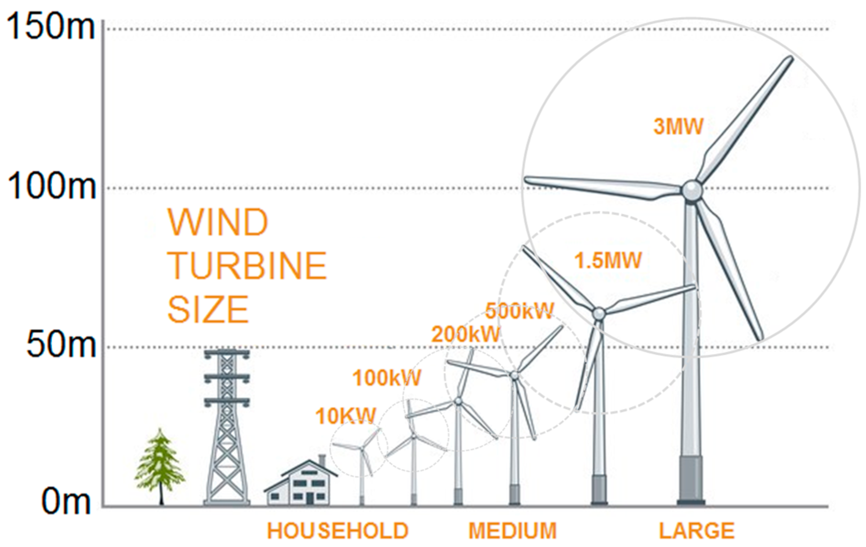

Slide 7
OSW Port Infrastructure related to a Hypothetical Solicitation Timeline for Maine
2023-2025 MeRA will require a primary port facility to install the 12-turbine research array.
2028-2030 The primary port facility is expanded to commercial-ready, anticipating roughly 120 turbines (S1+S2). O&M port online.
2031 Solicitation 1 approx. 800MW or 60 turbines.
2032 Solicitation 2 approx. 800MW or 60 turbines.
2032-2034 SOV port, a second marshaling and foundation manufacturing facility.
2035 Solicitation 3 1100MW
2037 Solicitation 4 1100MW
2040 Solicitation 5 1100MW

Slide 8
Types of OSW Vessels and Equipment
WTIV – Wind Turbine Installation Vessel. Large crane, jacking spuds, dynamic positioning.
SOV – Service Operation Vessel, vessels that are equipped to provide routine repair and maintenance to the wind farm
CTV – Crew Transfer Vessel, high speed and capable of moving crew from one place to the next.
Barge – Deck barges and semi-submersible barges are the most common.
Delivery Vessel – General cargo or heavy lift vessel that is used to transport WTG components to the marshaling facility. 8-10m draft.
Notes:
WTIV is unlikely to appear at a Floating OSW facility. Floating does not use WTIV’s, they are for installing turbines in shallower water.

Slide 9
Types of OSW Vessels and Equipment
AHTS – Anchor handling vessels. Specially designed to handle the large anchors that tether the floaters to the seafloor.
Cable Layers – Responsible for installing subsea cables between turbines and to the shoreline.
Helicopters – Extremely fast way to shuttle personnel to and from support vessels as well as hotshotting parts and equipment.
Cranes – Massive cranes on shore and mounted on vessels are required to move heavy components.
SPMT – Self Propelled Modular Transport. Similar to a tank without a turret.

Slide 10
Notes:
Maine will likely not see #8, anything else is possible.

Slide 11
Notes:
WTIV

Slide 12
Notes:
Semi Sub Barge

Slide 13
Notes:
Semi-sub HL vessel

Slide 14
Notes:
Cable Layer

Slide 15
Types of OSW Port Facilities
Marshalling – Marine cargo delivery, cargo storage, WTG assembly and construction. Also synonymous with ‘staging’.
Factory – Production facilities for WTG components (blades, nacelles, tower sections)
O&M – Routine operations and maintenance, transporting smaller pieces of equipment and personnel.
SOV Home Port – Refuel and restock SOV with larger components for maintenance.

Slide 16
Marshalling Facility
Generally 30+ acres in size. Component laydown takes up the majority of space.
Many commonalities for a fixed vs. floating facility. WTIV not necessary for floating facility.
Marine cargo delivery vessels call on a regular basis depending on the size of the laydown area. Tug and barge activity present.
Port of Esbjerg, Denmark. D1 OSW Terminal Belfast, Ireland.
Users include Port Authorities, OSW Developers, Engineering Contractors.
Traffic includes personal vehicles, weekly/monthly large commercial vessel traffic. 100-300 personnel depending on size.

Slide 17
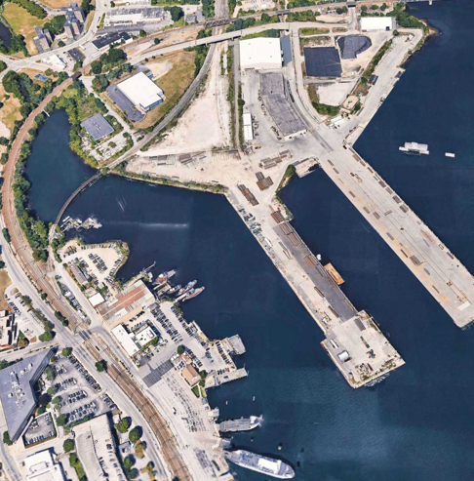
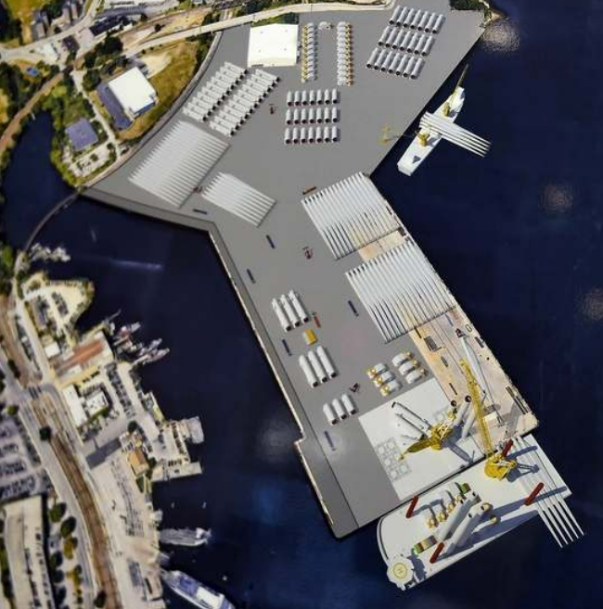
Notes:
New London State Pier, (L) existing, (R) expansion project concept. Facility about 30 acres.

Slide 18
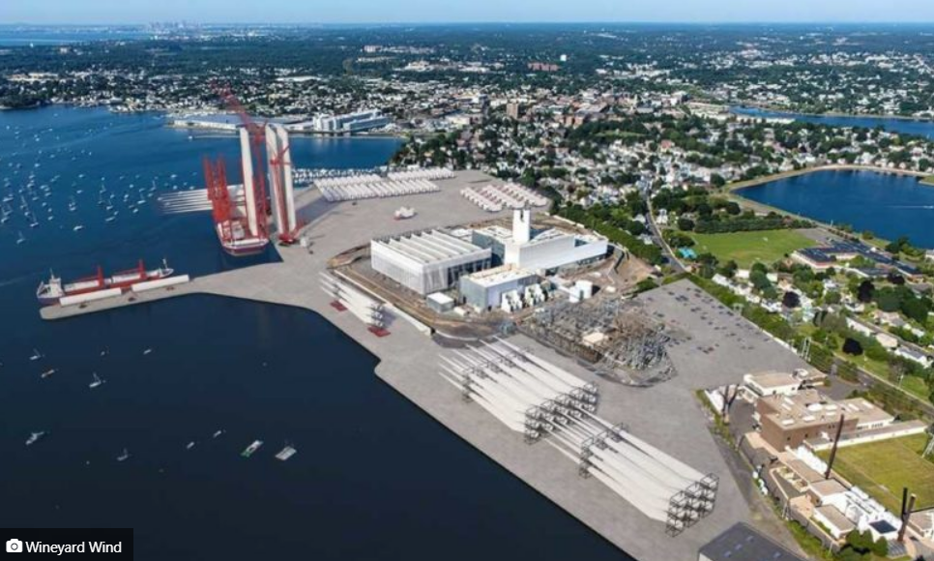
Notes:
Salem, MA – 42 Acre marshalling facility.

Slide 19
Notes:
Belfast Ireland – delivery vessel bringing in blades – towers in the foreground

Slide 20
Notes:
Belfast 50 acres – monopiles and transition pieces

Slide 21
Notes:
Esbjerg Denmark – Denmark’s Energy Metropolis, OSW terminal is about 150 acres. Competitive with Hamburg and Arhaus, Esbjerg has become Europe’s leading OSW port.

Slide 22
Notes:
Esbjerg Denmark

Slide 23
Notes:
Cromarty Firth – Nigg – These are jackets for fixed wind turbines. 182 acres

Slide 24
Notes:
Cromarty Firth Scotland

Slide 25
Notes:
NJ Wind Port – 200 acres, marshaling and manufacturing

Slide 26
Notes:
SPMT with hub and nacelle

Slide 27
Notes:
Delivery Vessel

Slide 28
Factory Facility
Production of components is done in specialized factories before loading onto a vessel for staging.
Blades, nacelles, tower sections and transition pieces are delivered from the factory to the marshalling facility.
Generally 60+ acres is required. Cranes are required to transfer components.
Typically see delivery vessels and barges. Raw materials arrive by barge, vessel, rail or truck. Components transported to the wharf by SPMT’s.
SIF Offshore Terminal at Maasvlakte 2, GE LM Wind Power Cherbourg, France.

Slide 29
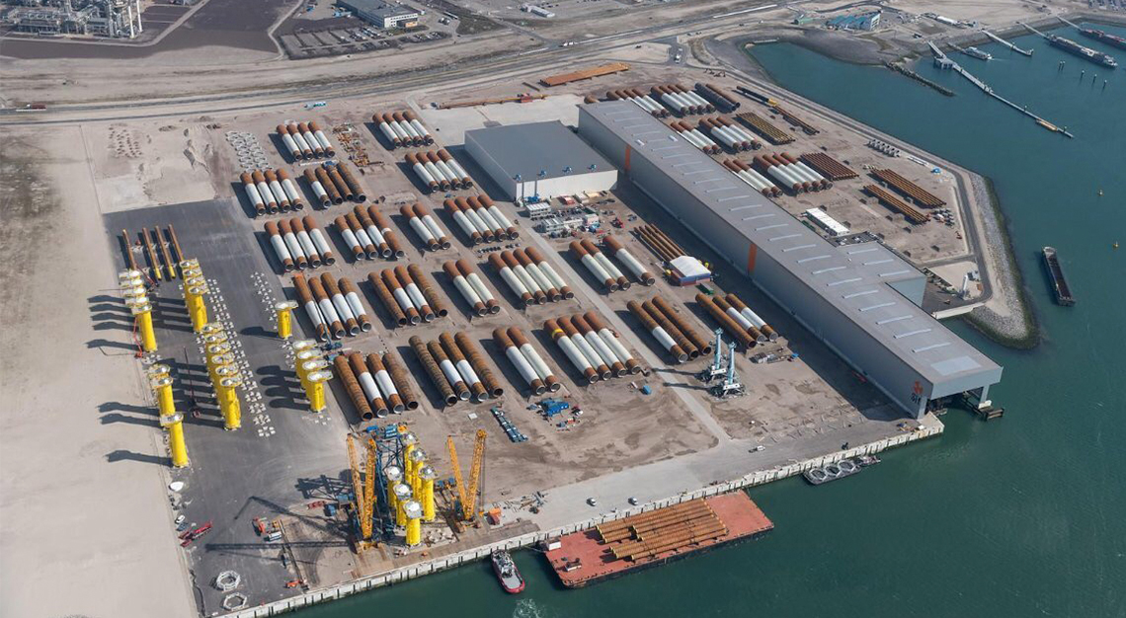
Notes:
SIF monopile factory @ Maasvlakte 2 Netherlands

Slide 30
Notes:
Delivery vessel departing blade factory

Slide 31
Notes:
Albany Tower Manufacturing Facility – 82 acres, tower section manufacturing

Slide 32
Notes:
Siemens Gamesa Blade Manufacturing – Hull, UK – about 80 acres

Slide 33
O&M Facility
Once installation is complete and wind farms are generating power, there is a need for routine O&M. Daily CTV voyages to and from wind farm.
Generally, require 3+ acres. Storage yard, forklift maneuvering area, offices and parking.
Transport personnel and smaller pieces of equipment. Cranes could be installed quayside.
Rampion at Newhaven, England.
Personnel arrive by car or bicycle.

Slide 34
Notes:
Rampion O&M Base

Slide 35
Notes:
CTV

Slide 36
Notes:
Sikorsky S-92, common aircraft for offshore operations

Slide 37
SOV Home Port
Supply support vessels with maintenance and operation equipment. Storage yard, storage warehouse, parking.
Min water depth 24ft. SOV makes 1-3 port calls per month to fuel and resupply. SOV stays for 1 day then departs.
Area required 1 to 3 acres.
Equipment and components delivered by barge, truck or rail.

Slide 38
Notes:
AHTS

Slide 39
Notes:
SOV

Slide 40
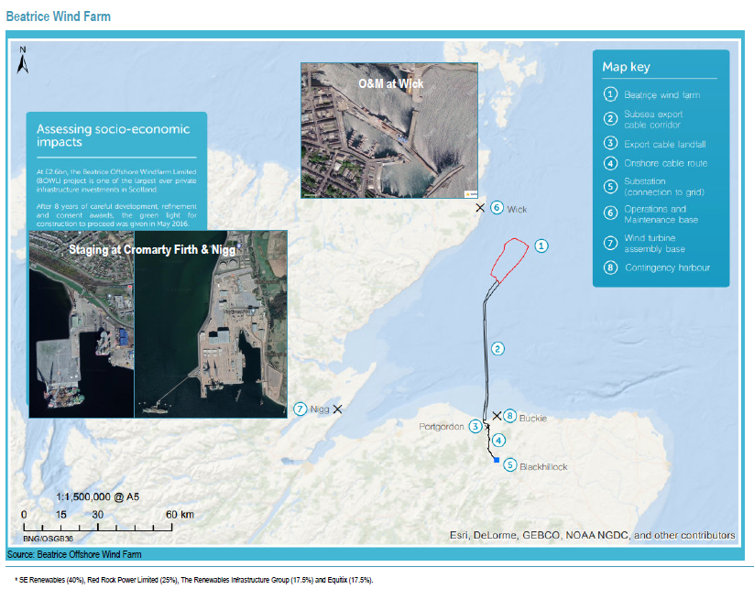
Notes:
Port network within 100km. 588MW wind farm with 84 &MW turbines.
Jackets manufactured throughout Europe. Blades in Hull, England. Nacelles in Germany. Staging at Nigg, O&M @ Wick.

Slide 41
Port Activity Level Questions
Noise – How loud is an OSW port facility?
How much truck and passenger vehicle traffic?
What is the level of cargo vessel activity?
How many individuals will work at an OSW facility?
What are the hours of operation?
How is the facility lighted? MTSA 105 requirements
Notes:
Noise – See slide on dB analysis
Cargo Vessel Activity – It depends on staging area, but several vessels a month is likely for delivery. OSV/Tug traffic will be weekly.
Truck and Pax traffic – Facility may employ somewhere between 100-300 people. Steady pax vehicle ingress and egress at shift change. Pax and materials may be transported by barge which alleviates a lot of traffic.
Hours of operation – depends on production level, but could expect 24/7 activity
Lighting will follow MTSA requirements. Similar to marine terminals throughout the state and country.

Slide 42
Noise – There are no conclusive studies specific to an OSW terminal.
Cranes – 90-115dB
Ship Generators – 100-115dB in machinery space
Truck Traffic – 70-80dB
Marine Cargo Handling – Typically below 75dB
Studies on shipyard dB levels show a wide range with no activity above 110dB
Mack Point a good reference due to WTG component handling.
Noise level will vary by location at the terminal.
Noise level will increase at different times of the day depending on activity.
Notes:
No specific studies on OSW terminals. We can get a good idea of noise level by looking at other marine facilities and our experience with Sprague – Mack Point.

Slide 43
Vessel and Vehicle Traffic
Trucks will need to access the facility daily, but large components delivered by sea. This will reduce congestion significantly.
Personnel can access by personal vehicle/bicycle, shuttle, or vessel.
Large vessels deliveries will be less frequent depending on size of laydown area.
Tug and Barge traffic may be frequent depending on raw material storage capacity on site.
Delivery vessels are typical general cargo vessels.
Anticipated production rate of 1 WTG every week at commercial scale production.
Rail access can reduce truck traffic.
Steady amount of support vessels will transit to and from the port, however congestion is unlikely.

Slide 44
Closing Points to Make
Many proposed OSW port facilities include marshalling and manufacturing sites. Higher value elements (blades, nacelles) may be produced in the USA once the industry matures.
Cost of these facilities is often exceeding $100million in initial improvements. Most of these developments are public/private partnerships.
Most facilities are being developed on existing infrastructure but need significant rehabilitation and new construction to make them suitable for use in OSW.
Average life of a wind farm is 25 years. In that timeframe, there will be a significant amount of vessel traffic to and from the installation site for maintenance and repair exercises.
Development of port infrastructure will catalyze job creation in Maine. This will occur in phases with a hub location to support the installation of the MeRA, and then expansion into a commercial-ready facility.
The efficiencies of a port network in proximity to the installation site has proven to be a downward cost driver and beneficial for communities.

